Slide 1
COMP 504
Presentation
Group Doge
(Team D)

Slide 2
About out team
Team Name: Dog
Team Lead: Lize Chen
Tech Lead: Huaminghui Ding
Documentation Lead: Tingting Li
Developer: Daolun Chen
Developer: Ruimin Li
Developer: Yichen Sun
Developer: Junhao Yu

Slide 3
User Interface
https://chatapp-final-team-dog.herokuapp.com/
Button Design
Make it easy to find and predict
User-friendly
Obvious Interface
Clear and Self-evident

Slide 4
Demo
##

Slide 5
Demo
Log in
Register
Create
Join
Update info
Send message
Hate speech
Chat
Invite
Mute
Block
Kick
History
Notification
Leave

Slide 6
Use Cases
##

Slide 7
 | admin | member
Create a chat room | 1 | 0
Join a chat room | 1 | 1
Send messages | 1 | 1
Mute others | 1 | 0
Kick others | 1 | 0
Send notifications | 1 | 0
Block others | 1 | 0
Chat with one user | 1 | 1
Invite users | 1 | 0
See chat history | 1 | 1
Leave a chat room | 1 | 1
 | Group chat room | User chat room
create | Created by an owner | Created when user A chats directly with user B in the same group
Number of people | >=2 | 2
message | broadcast | direct
feature | Chat, Mute, kick, block, invite, history, notification, leave | Chat, leave

Slide 8
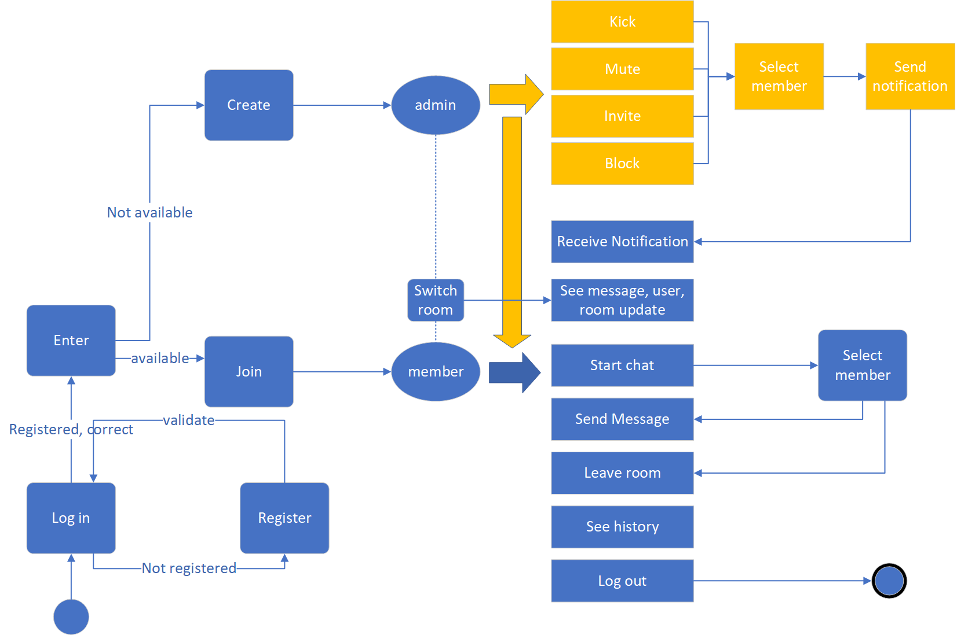
User Diagram

Slide 9
API Design
##

Slide 10
Server API
endpoint | verb | payload | response | description
/login | post | Username, password | User object | Check if username is in UserDB and then check if the password is correct.
/register | post | Username, school,age, interests, password | true | Check if the username is in UserDB, if in, then return false.
/userInfo | post | username | User object | Find a specific user
/roomInfo | post | roomName |  | Find a specific room
/join/getRooms | post | username | A List<ChatRoom> object | Get all rooms a user not join yet.
/join/group | post | Username, roomName | ArrayList<ChatRoom> | Check and add a validate user to a group.
/join/notification/accept | post | Sender, receiver, roomName | A string | Put the applicant into the room member list.

Slide 11
Server API
/join/notification/reject | post | Sender, receiver, roomName | A string | Send a rejection notification to the applicant.
/logout | get | username | true | To let a user log out and remove the session related info.
/room/update | get | username | List<ChatRoom> | Update room list per 0.1 second .
/room/members | get | Username,roomname | List<String> | Get the member list of a given roomId.
/create/groupchat | post | roomName, maxUser, isPublic, password, interest, username | boolean | Create a new group chat.
/chat/getUsers | post | username | List<User> | Get users except the current user.
/create/userchat | post | Username, chatName,room | boolean | Create a new user chat.

Slide 12
Client request
getSendMsgRequest getLoginRequest getInviteRequest getMuteRequest getKickRequest getBlockRequest
getLeaveRequest getUpdateMsg getLogoutRequest getDeleteRequest getRecallUpdateRequest getInviteUsersRequest

Slide 13
Model Description
##
With all UML diagrams
For all abstract classes and interfaces

Slide 14
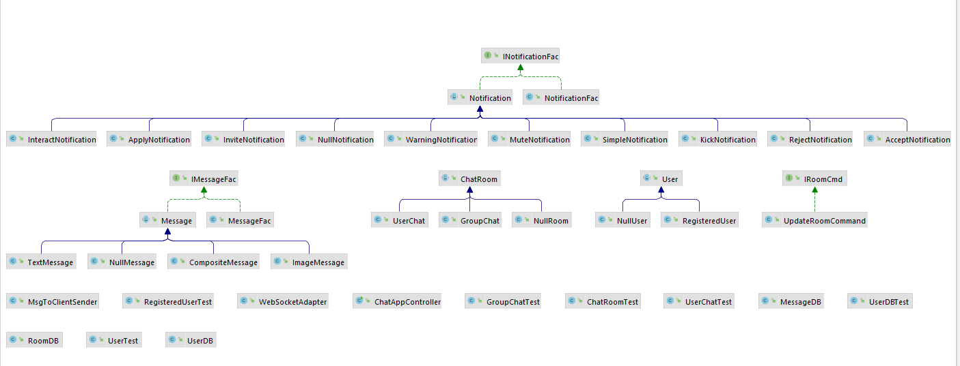
UML

Slide 15
Design Pattern
##

Slide 16
Design pattern
Factory design pattern
NotificationFac - make different kinds of notifications
MessageFac - make different types of messages
RoomCmdFac - make a command
RoomStrategyFac - make a specific room related strategy
Null object design pattern
NullNotification, NullUser, NullRoom, NullMessage - for default use and prevent null pointer
Singleton design pattern
NullNotification, MessageFac, NullMessage – only one instance of the class is needed

Slide 17
Design pattern
Composite design pattern
CompositeMessage - ArrayList of text and images
Template design pattern
Interface and abstract class - set up invariant
concrete subclasses - implement specific variant details
MVC design pattern
controller - instantiates the adapter and communicates with the model and view

Slide 18
THANKS Q & A

